Slide 1
The Last Telegram

Slide 3
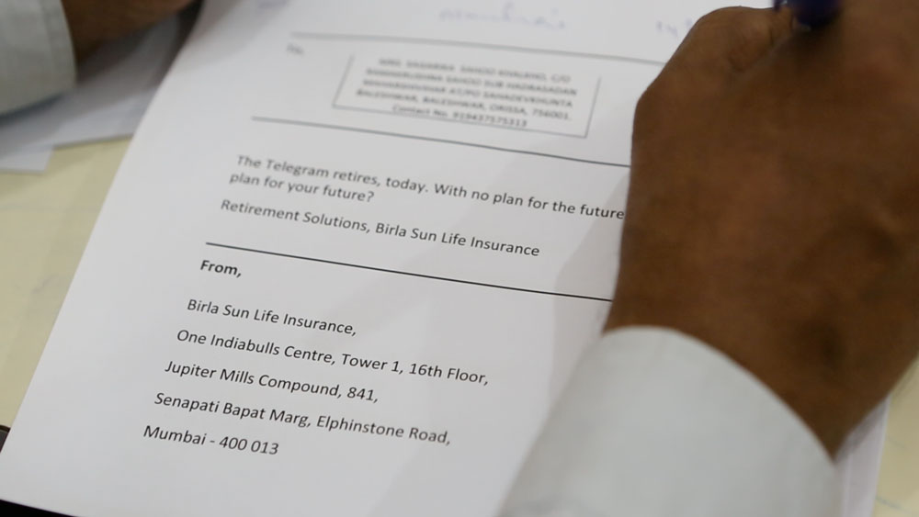

Slide 4
